Slide 1
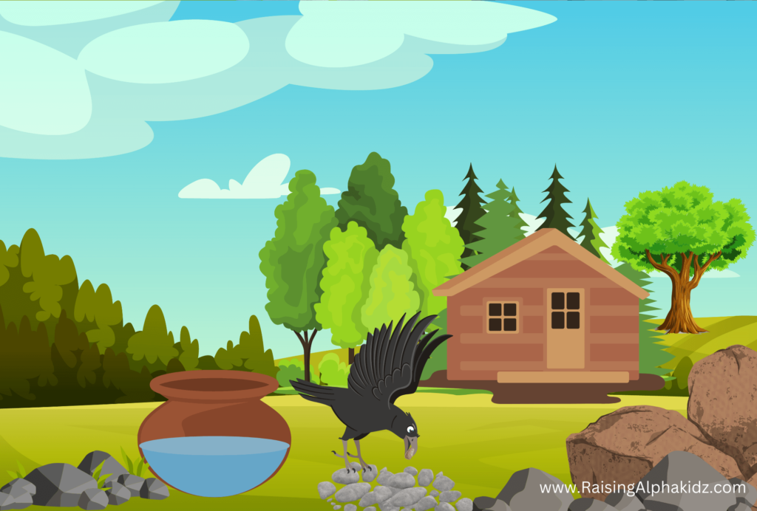
The Thirsty Crow

Slide 2
Once there was thirsty crow living in dry forest who was searching for water everywhere but all in vain.
After some efforts he saw a pot filled with half of water. The crow wasn’t able to reach the water level in the pot.

Slide 3
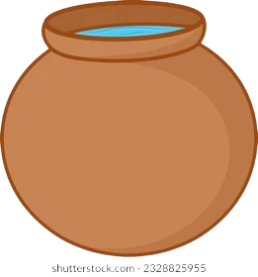
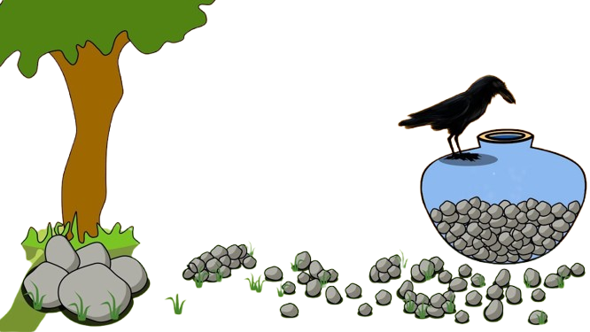
He started picking pebbles from nearby and filled the pot with them.
As a result, the crow was able to reach the water level in the pot and drank it.

Slide 4
He drank the water and fulfilled his thirst and flew back happily proving that he was a clever crow.

